Slide 1

Introduction
Execution
Strategy
Team Description
Problem Statement
Team Leader Member
Kumari Ankita Khusboo Kumari
2201ME39 2201CE25
Mechanical Civil
Indian Institute of Technology, Patna
[Backend, Ideation] [Frontend]
Automating the Information Extraction from Semi-Structured Interview Transcripts:
It aligns with my experience in data analysis and is a real-world issue faced by researchers thus I chose this problem statement.
Benefits
Challenges
Time Efficiency:
Automation can save hours of manual effort involved in reading, analyzing, and summarizing transcripts, especially for lengthy or large dataset.
Cost Savings:
Cuts down on the need for a large team of human annotators or analysts.
Enhanced Accessibility:
Summarized or categorized data makes it easier for non-experts to understand key insights without diving into raw transcripts.
CORS Issues in React-Backend:
Challenge: React frontend couldn’t communicate with Flask API due to CORS restrictions.
Solution: Used Flask-CORS to enable frontend-backend communication.
Asked a developer friend, Flask-CORS documentation.
LLM Hallucination:
Challenge: LLM was generating unrelated responses.
Solution: Used structured system prompts to enforce factual, JSON-formatted outputs.
https://platform.openai.com/docs/guides/structured-outputs
Target Group
Researchers in social sciences, business analytics, healthcare, HR
Organizations conducting market research, surveys, policy analysis like CRISIL

Slide 2
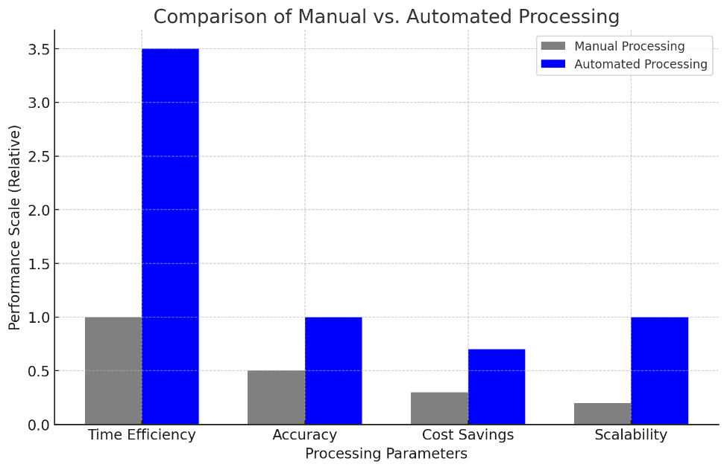
Introduction
Execution
Strategy
Control Flow
Frontend
Upload Transcript
File Validation
Structured Topics
Action Selection
Co-occurrence Graph
Backend
Analysis Pipeline
Data Ingestion & Validation
ML Pipeline
Text Processing Pipeline
Embedding Generation
Preprocessing Engine
Tokenization & Cleaning
Comparison of Manual vs. Automated Processing (Time & Cost Savings in %)
FAISS Vector Index
LLM Engine
Frequency Analysis
Co-occurrence Matrix
RAG
Distribution Table
Topic Visualization
Output
Topic Clusters
Named Entities
Sentiment Analysis
Thematic Analysis
Strategic Insights
Summary

Slide 3
Introduction
Execution
Strategy
Technology Used
Future Scope
Backend : Flask, FAISS, Together AI API
NLP Libraries : NLTK, Sentence-Transformers, Meta Llama-3
Database : FAISS (Vector Search)
Frontend : React (Next.js)
Multi-language Support: Extending beyond English to cater to global research.
Real-time Speaker Differentiation: Automatically detecting who’s speaking in multi-person interviews.
Integration with Notion or Google Docs: Seamlessly export your structured summaries to popular collaboration platforms.
Enhanced Visualizations: Word clouds, interactive dashboards, and deeper analytics to help you see patterns at a glance.
Proposed Solution
A Flask-based NLP system that automates topic extraction, sentiment analysis, and thematic visualization from interview transcripts.
Uses advanced NLP models (LLM, Sentence Transformers, FAISS indexing) to process data without programming knowledge.
Provides structured summaries, keyword frequency analysis, and visual representations of topic interconnections.
Features
Preprocessing: Removes stop words, punctuation, and normalizes text.
Thematic Analysis: Identifies key topics, entities, and relationships.
Sentiment Analysis: Extracts positive, negative, or neutral sentiments.
Graph Visualization: Displays interconnectedness of extracted topics.
Automated Summary Generation: Generates structured reports for easy interpretation.

